Slide 1

Marathwada Mitra Mandal's
COLLEGE OF ENGINEERING, Karve Nagar, Pune - 52
An Autonomous Institute Affiliated to SPPU
Website: www.mmcoe.edu.in email id: mmcoe@mmcoe.edu.in
Department of Information Technology
Project Based Learning - Review 1 (AY 2025-26)
“SwachhaMitra- Report Trash, Earn Rewards”
Presented By: SI160 – Rushikesh.D.Gadekar
SI146 – Sharvari.S.Aralkar SI134 – Nikita.N.Kumbhar SI164 – Aditya.B.Patil
Name of Guide: Mrs.P.S.Joshi
Date:04/09/2025

Slide 2
CEP Project Title
Title 1
Context of the project :-
Urban areas are facing persistent waste management challenges due to unreported and unattended garbage piles. These uncollected wastes not only degrade the city’s aesthetic appeal but also create serious public health hazards, including the spread of
diseases through pests and contamination of soil and water. Existing reporting systems are often slow, inconvenient, or poorly integrated with municipal response teams, leading to significant delays in action.
Area/Community of focus :-
The project focuses on urban and semi-urban localities.

Slide 3
Recap of Selected Problem
Problem Statement :-
Uncollected garbage in urban and semi-urban areas creates unhygienic conditions, spreads diseases, and affects the environment and quality of life. At present, citizens lack a quick and user-friendly platform to report such issues, and municipal authorities struggle with delayed information, poor coordination, and lack of real-time updates. This communication gap results in inefficiency and dissatisfaction among citizens.
Objectives :-
Provide a mobile app for quick garbage reporting with photos and GPS location.
Enable real-time communication between citizens and municipal authorities.
Allow transparent tracking of report status until resolution.
Introduce a reward system to encourage citizen participation.
Improve efficiency and accountability in municipal waste management.

Slide 4
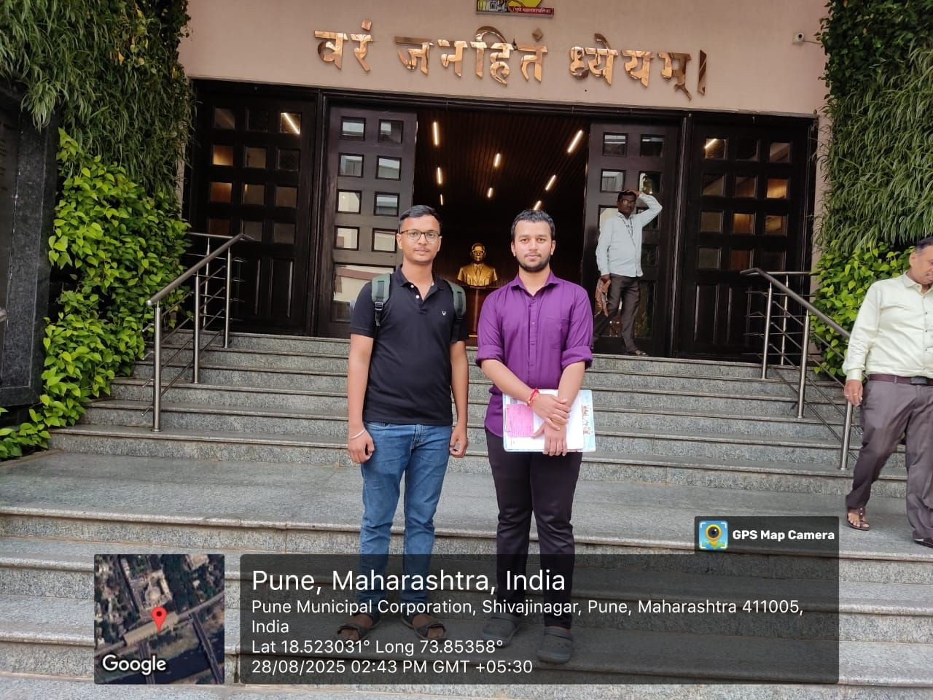
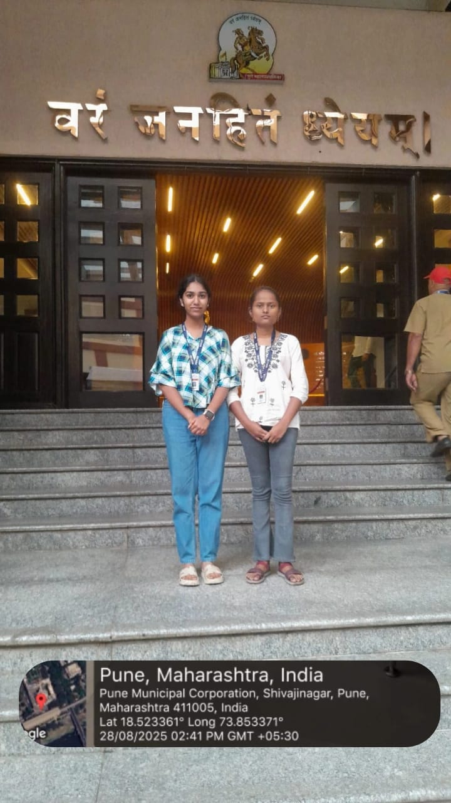
Community/ Field Visit
Area visited
Pune Municipal Corporation (PMC) – Selected urban zones for field study and stakeholder consultation.
People consulted
  PMC Sanitation Officers
  Local Residents / Citizens
  Waste Collection Staff
Photos

Slide 5
Data Collection and Analysis
Survey Results and Interviews
Most residents were unaware of existing reporting apps like CARE or Safai Mitra.
Reporting garbage is mostly done through phone calls or in-person visits; few use apps.
Residents are willing to use a simple, fast app.
Preferred reporting methods include photo with GPS location, location only, or text description. Many residents are dissatisfied with the current garbage collection system.
Key Patterns:
Most residents are unaware of existing garbage reporting apps.
Reporting is mainly done via phone calls or in-person.
Residents are willing to use a simple app with GPS/photo features.
Municipal staff face delays in tracking and resolving complaints.
Insights Drawn:
Need for a user-friendly, real-time reporting web application.
Dashboard for staff can improve complaint management.
Rewards system can encourage citizen participation.

Slide 6
Data Collection and Analysis
PMC Sanitation Officers
Q1. What challenges do you face in monitoring garbage collection? A1. Tracking citizen complaints in real time and ensuring timely action.
Q2. How do you track the status of reported complaints?
A2. Status is updated manually or via the CARE app dashboard.
Q3. What improvements would you suggest for a reporting system like CleanSnap? A3. Real-time updates, GPS tracking, photo verification, and better dashboard features.
Q4. Would a pilot app for one ward help improve efficiency?
A4. Yes, a pilot can identify practical challenges and improve workflow.
Citizens
Are you aware of any apps to report uncollected garbage?
A1. Most residents know about CARE; very few know about Safai Mitra.
Q2. How do you currently report garbage issues?
A2. Mostly via phone calls or visiting ward offices; app usage is limited.
Q3. Would you use a new app if it made reporting easier? A3. Yes, most residents are willing to try a simple, fast app.

Slide 7
Constraints and Challenges
Technical Constraints
Integration with PMC CARE app may require approvals.
Real-time updates may fail in poor network areas.
Operational Challenges
Staff workload may delay complaint resolution.
Multi-department coordination can slow progress.
User-Related Challenges
Low citizen awareness of reporting apps.
Elderly/non-tech users may face difficulty.
Regulatory & Privacy Constraints
Sensitive user data requires strong privacy measures.
Approvals needed from Commissioner and departments.
Field Challenges
Mixed waste makes categorization difficult.
Irregular collection or traffic may delay response.
GPS may be inaccurate in dense areas.

Slide 8
Ideas for Possible Solutions
Proposed Approach 1: Pilot Ward Deployment
Description: Develop a prototype version of Clean Snap and deploy it in one selected ward of Pune.
Key Steps:
  Coordinate with PMC IT, SWM, and ward officers to get necessary approvals. Enable residents in the ward to report garbage via GPS, photo, and issue description.
  Track reports through a simple admin dashboard for municipal staff.
  Collect feedback from residents and staff regarding usability, speed, and effectiveness.
Goal: Test app feasibility, identify challenges, and gather data for improvement before city-wide rollout.

Slide 9
Q and A

